Slide 1
Mutual Fund Analytics Project
Capstone Project
Submitted By :
Shreyash Pise
Bluestock Fintech Intership

Slide 2
Project Overview :-
Objective:
• Analyze mutual fund performance
• Clean and validate financial data
• Build SQL database
• Perform Exploratory Data Analysis
• Calculate financial metrics
• Generate insights for investors
Tools Used:
• Python
• Pandas
• SQLite
• SQLAlchemy
• Matplotlib
• Seaborn
• Plotly
• Git & GitHub

Slide 3
Project Architecture
Raw CSV Data
↓
Data Ingestion
↓
Data Cleaning
↓
Processed Data
↓
SQLite Database
↓
EDA Analysis
↓
Performance Analytics
↓
Insights & Reports

Slide 4
Dataset Description
Objective
The project uses mutual fund industry datasets to analyze fund performance, investor behavior , risk metrics, and market tree
1. Fund Master Dataset
File:fund_master.csv
Purpose: Contains master information about mutual fund schemes.
Key Columns:
amfi_code scheme_name fund_house category plan risk_grade expense_ratio_pct
2. NAV History Dataset
File:
nav_history.csv
Purpose:
Stores historical Net Asset Value (NAV) data for mutual funds.
Key Columns:
amfi_code date nav
3. Scheme Performance Dataset
File: scheme_performance.csv
Purpose : Contains performance and risk metrics for each scheme.
Key Columns:
return_1yr_pct return_3yr_pct return_5yr_pct alpha beta sharpe_ratio sortino_ratio
4. Investor Transactions Dataset
File: investor_transactions.csv
Purpose : Contains investor transaction details and investment patterns.
Key Columns:
investor_id transaction_date transaction_type amount_inr gender state

Slide 5
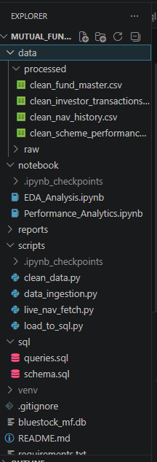
Day 1 - ETL & Data Ingestion
Tasks Completed:
✓ Created project structure
✓ Set up Python virtual environment
✓ Installed required libraries
✓ Loaded CSV datasets
✓ Fetched live NAV data using AMFI API
✓ Saved raw data in CSV format
✓ Configured Git and GitHub
✓ Uploaded project repository

Slide 6
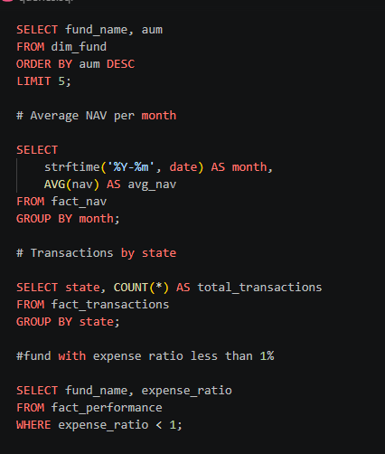
Day 2 - Data Cleaning & SQL Database Design
Data Cleaning:
✓ Removed duplicates
✓ Handled missing values
✓ Converted data types
✓ Validated NAV values
✓ Standardized transaction types
Database Design:
✓ SQLite database created
✓ Fact tables
✓ Dimension tables
✓ Data dictionary prepared

Slide 7
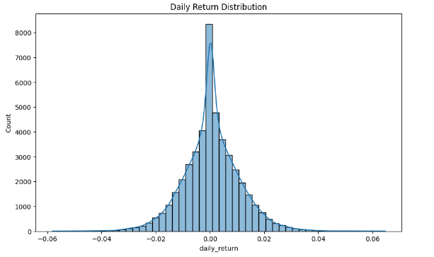
Day 3 -Exploratory Data Analysis
EDA Performed:
✓ NAV Trend Analysis
✓ AUM Analysis
✓ SIP Inflow Analysis
✓ Geographic Distribution
✓ Category Heatmaps
✓ Correlation Analysis
✓ Investor Demographics

Slide 8
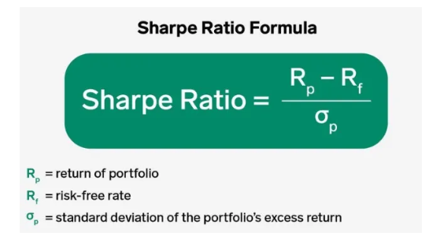
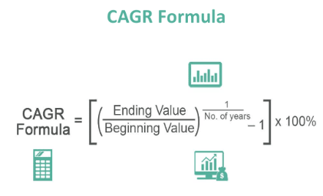
Day 4 - Fund Performance Analytics
Metrics Calculated:
✓ Daily Return
✓ CAGR
✓ Sharpe Ratio
✓ Sortino Ratio
✓ Alpha
✓ Beta
✓ Maximum Drawdown
✓ Fund Ranking Scorecard

Slide 9
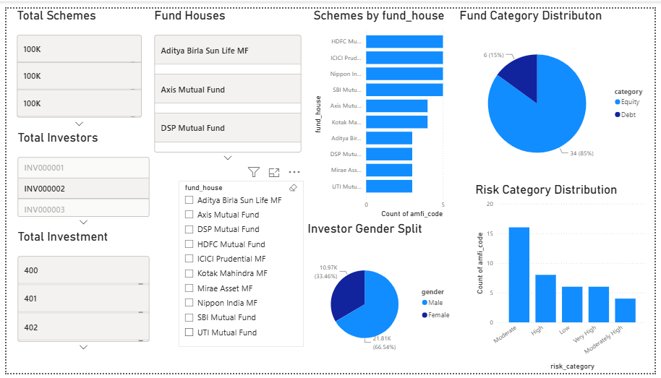
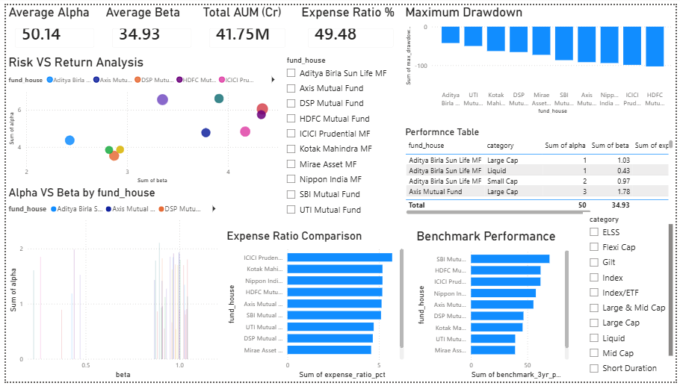
Day 5- Interactive Power BI Dashboard
Figure 1: Industry Overview Dashboard
Figure 2: Fund Performance Dashboard

Slide 10
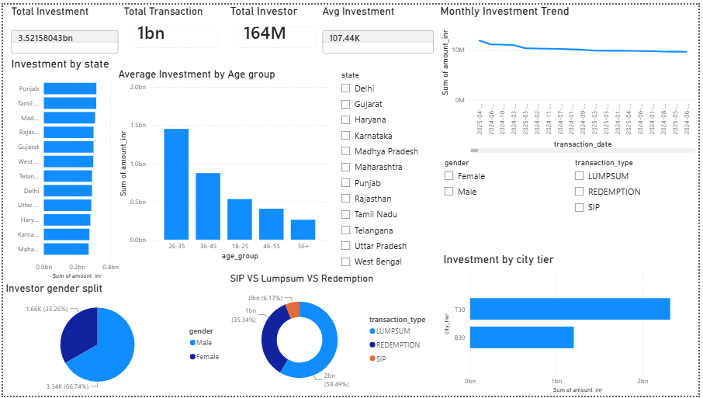
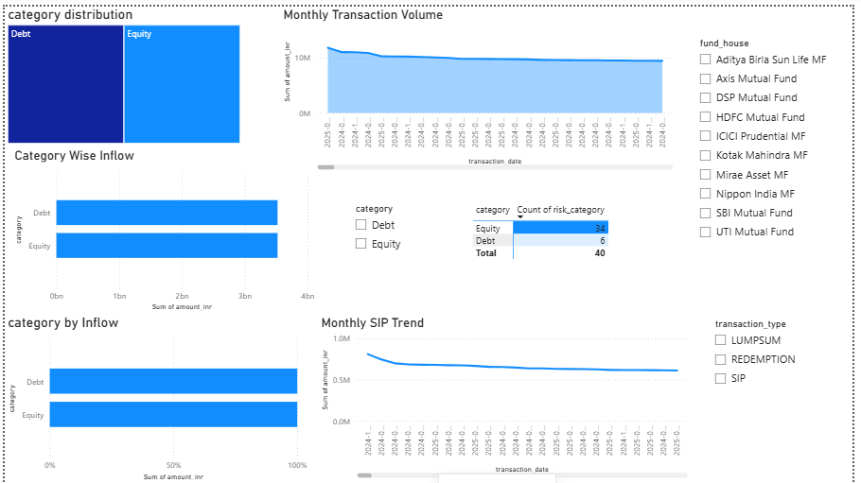
Figure 3: Investor Analytics Dashboard
Figure 2: SIP & Market Trends Dashboard

Slide 11
Day 6- Advanced Analytics & Risk Assessment
Objective
Perform advanced risk analysis and investor behavior analytics using historical NAV and transaction data.
Implemented Techniques
1. Historical Value at Risk (VaR)
Confidence Level: 95%
Measures maximum expected portfolio loss.
2. Conditional Value at Risk (CVaR)
Measures average loss beyond VaR.
Captures tail risk.
3. Rolling Sharpe Ratio
90-Day Rolling Window
Evaluates risk-adjusted returns over time.
4. Investor Cohort Analysis
Grouped investors by transaction year.
Analyzed long-term participation.
5. SIP Continuity Analysis
Identified investors with consistent SIP contributions.
6. HHI Concentration Index
Measured concentration of assets across funds.
Deliverables Generated
var_cvar_report.csv rolling_sharpe_chart.png Advanced_Analytics.ipynb recommender.py

Slide 12
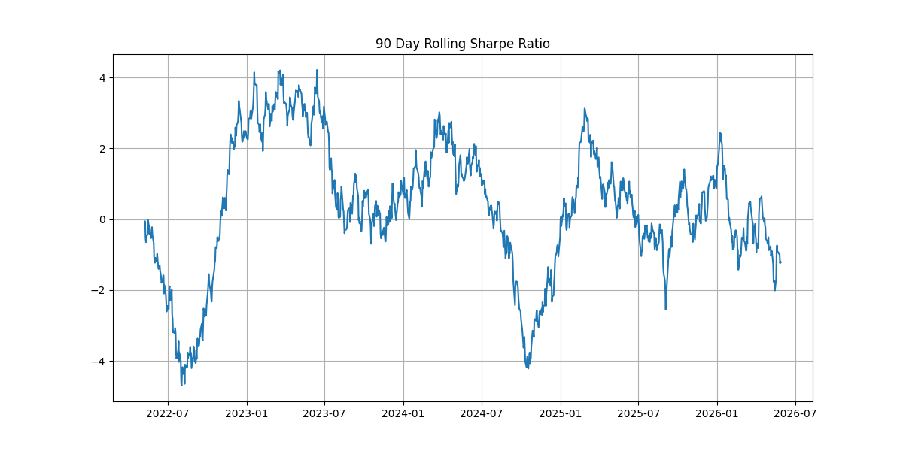
Risk Analytics Results & Insights
Key Findings
High Sharpe Ratio funds delivered superior risk-adjusted performance.
CVaR values were lower than VaR, indicating higher downside risk during market stress.
Consistent SIP investors showed stronger investment discipline.
A small number of funds controlled a large share of total AUM.
Moderate-risk funds provided the best balance between return and volatility.
Business Impact
Supports informed investment decisions.
Helps identify high-performing mutual funds.
Assists investors in understanding risk exposure.

Slide 13
Key Insights
1. SBI Mutual Fund has highest AUM.
2. SIP investments increased steadily over time.
3. Equity funds outperform debt funds.
4. High-risk funds show higher volatility.
5. Expense ratio impacts long-term returns.
6. Strong correlation observed among equity categories.

Slide 14
Technologies Used
Technology | Purpose
Python | ETL and Analysis
Pandas | Data Processing
SQLite | Database
SQLAlchemy | Database Connection
Matplotlib | Visualization
Seaborn | Visualization
Plotly | Interactive Charts
GitHub | Version Control

Slide 15
Conclusion
Project Conclusion
Achievements
Data Ingestion & Processing
Data Cleaning & Validation
Exploratory Data Analysis
Performance Analytics
Power BI Dashboard Development
Advanced Risk Analytics
Final Outcome
Developed a complete Mutual Fund Analytics Platform capable of:
Data Processing
Risk Assessment
Performance Evaluation
Investor Analytics
Interactive Dashboard Reporting
Thank You

